Slide 1
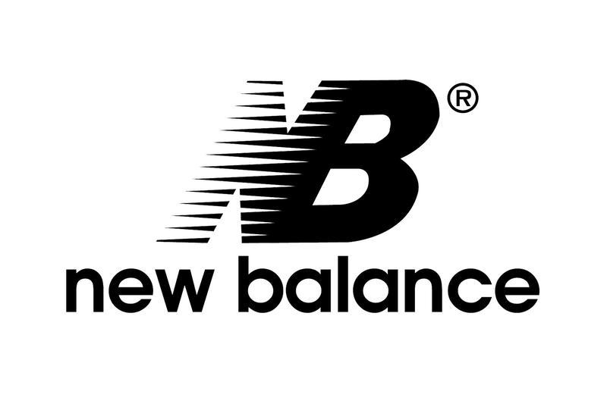
Sneakers 2013 vs. Persistence
Reid Zuerlein, Jacob Baron, Ben Hoffman, Lucas Lantis

Slide 2
The Recommendation: Sneakers 2013
Sneaker 2013:
Higher NPV: $32,700,683
Lower Payback Period: 4.07 Years
IRR exceeds cost of capital (11%): 16.05%
Persistence:
Lower NPV: -$29,453,750.45
Higher Payback Period: 4.07
IRR lower than cost of capital (14%): 7.21%
Less reliable forecast

Slide 3
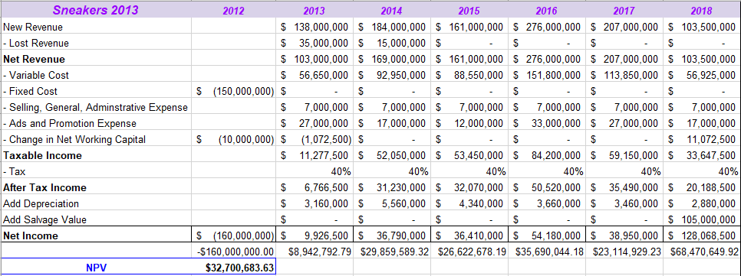
Sneakers 2013: Cash Flows
R&D costs, depreciation costs, and interests costs are not included in the cash flow calculations
R&D is a sunk cost
Depreciation is a non-cash account
Interest costs are incorporated in the WACC formula

Slide 4
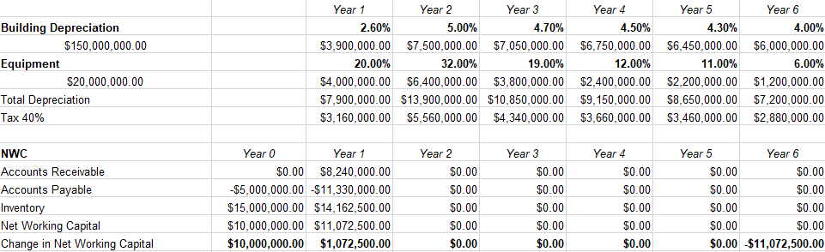
Sneakers 2013:
Depreciation & NWC

Slide 5
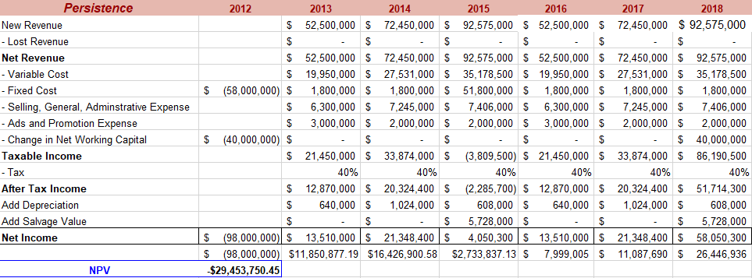
Persistence:
Cash Flows
Depreciation costs, and interests costs are not included in the cash flow calculations
Design cost is included because if the project is not pursued, the purchase wouldn’t be made
Depreciation is a non-cash account
Interest costs are incorporated in the WACC formula

Slide 6
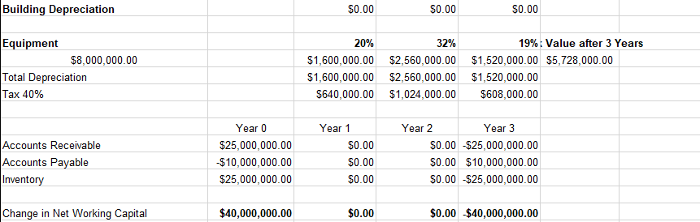
Persistence:
Depreciation & NWC

Slide 7
Risk Comparison
We believe that Sneaker 2013 has less risk compared to Persistence
New Balance has a long history of producing competitive running shoes and should be able to forecast that market better due to experience
Hiking shoes would be a new business line for New Balance, which would require outsourced design
If New Balance cannot design the shoe, it is reasonable to believe their financial forecasting would not be as accurate as it could be
Persistence would have to outperform our forecast significantly to become a worthwhile investment for shareholders, as shown by its negative NPV and low IRR

Slide 8
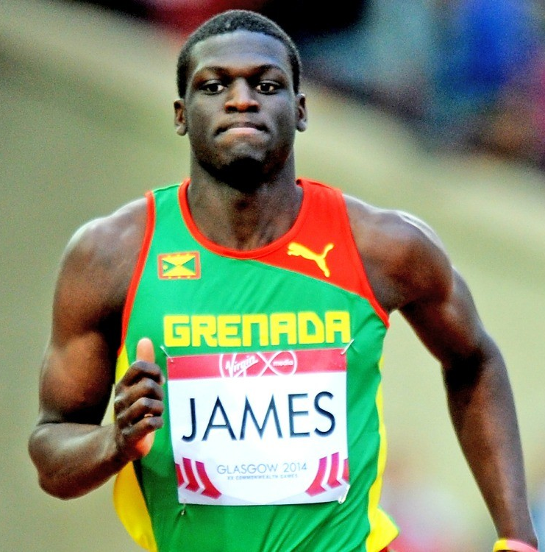
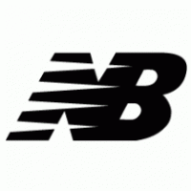
Conclusion:
Our final recommendation is to pursue the Sneaker 2013 project over Persistence
Project Persistence has a negative NPV and an IRR lower than the project’s cost of capital
This suggests that the project would not return positive cash flows to shareholders
Project Sneaker 2013 does has a positive NPV as well as an IRR which is higher than the cost of capital. Further, there is an acceptable payback period of 4.07 years.
This suggests that the project would quickly produce a better return for shareholders, relative to New Balance’s current business
Kirani James, New Balance Athlete and 2012 Olympic Gold Medalist

